Slide 1
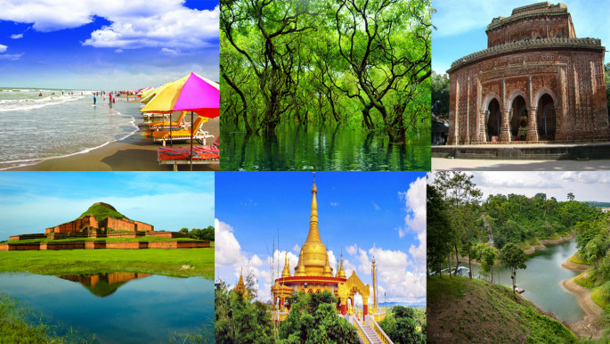
TOUR PLANNING: A TIME-CONSCIOUS TOURIST PLACES RECOMMENDATION SYSTEM
Supervised By
Dr. Md Mostofa Kamal Rasel

Slide 2

Group Members
Fima Faria Lisa
- 2020-1-60-026
Noshin Tasnim Khan
- 2020-1-60-221
Farhana Jaman
- 2020-1-60-006
Ayesha Chowdhury
- 2020-1-60-003

Slide 3



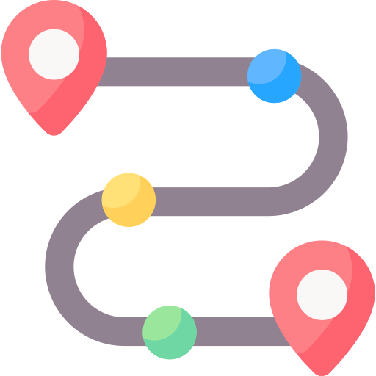
Introduction
Definition A tourist recommendation system helps plan tours by providing personalized recommendations.
How Does a Tourism Recommendation System Work? Uses data like preferences, history, and context to suggest destinations and accommodations aligned with user interests.
Existing Recommendation Systems Existing systems consider likes, history, location, distance and cost, to recommend multiple places.
What else can be offered? Suggests optimal routes based on user preferences, time, and location.

Slide 4
Literature review
1
2
Traveler’s Recommendation System Using Data Mining Techniques:
Measuring Tourist Experience in
Semarang City through an Advanced Recommendation System
Considers user interests, location, and hobbies, and filters out visited places.
Uses Euclidean distance to find the distance between the user and attractions.
Employs KNN algorithm for identifying the nearest attractions based on the Euclidean distance.
Uses the Apriori algorithm to recommend the most visited places associated with a starting point.
Limitations:
Euclidean distance may not reflect real-world scenarios.
Does not account for travel time constraints.
Recommends only one place from the suggested spots.
Does not provide travel routes or sequences for visiting multiple places within a specific timeframe.
Develop a recommendation system using content-based and collaborative filtering techniques.
Collaborative filtering highlights local favorites.
Content-based filtering suggests top-rated destinations based on user ratings.
Limitations:
Does not account for travel time constraints.
Recommend only one place to visit from their list of suggested spots.
Does not provide travel routes and sequences for visiting multiple places within a specific time.
Shrikant Kokate et. al. “Traveler’s recommendation system using data mining techniques”. (2018) ICCUBEA’2018.
Sutomo, R., & Kaisha Pratama, D. “Measuring Tourist Experience in Semarang City through an Advanced Recommendation System”. (2023) Jurnal Komunikasi Sains Dan Teknologi.

Slide 5
Literature review
3
4
A Tourism Route-Planning Approach Based on Comprehensive Attractiveness:
Tour Spot Recommendation System via Content-Based Filtering
Uses Content-Based Filtering to suggest picnic spots based on user interests and budget
Recommends spots based on past visits or gathers preferences for new users to suggest spots they might like.
Suggest top picnic spots based on location, budget, safety, transport, and climate.
Limitations:
Does not consider traveler’s travel time constraints.
Does not consider current location, travel routes, and sequences for visiting multiple places.
Considers the distance between sites, initial travel position, initial departure time, time duration of tour, total cost, scores, and popularities of sites.
A comprehensive attractiveness index rated routes.
Uses simulated annealing, greedy algorithm, and genetic algorithm where genetic algorithm performed best.
Uses real-world data from Baidu and Xiecheng, including information on 20 classic sites in Beijing.
Limitations:
Conducts on a small dataset.
However, if the dataset becomes larger, then time complexity increases exponentially that affects the real time recommendation.
3.M. Muneer, U. Rasheed, S. Khalid, and M. Ahmad. “Tour Spot Recommendation System via Content-Based Filtering”. (2022) 16th International Conference on Open Source Systems and Technologies .
4. Yanmei Zhang et. al. A Tourism Route-Planning Approach Based on Comprehensive Attractiveness. (2020). IEEE Journals & Magazine | IEEE Xplore.
https://ieeexplore.ieee.org/abstract/document/8963860

Slide 6
Issues in the existing system
One research uses Euclidean distance, which may not accurately reflect real-world distances.
Recommend only one place to visit from their list of suggested spots.
01
04
None of them considers recommending the tour plans based on the endpoint
None of them considers recommending the tour plans based on the endpoint.
Most of the system does not account for travel time constraints.
02
05
One research was conducted on a small dataset. However, if dataset becomes larger, then time complexity increases exponentially that affects the real time recommendation.
Limited data availability in one of this systems may affect recommendation accuracy and also Recommendations may be biassed based on the dataset used.
03
06

Slide 7

Motivation
Traditional travel recommendation systems often overlook how many places travelers can visit within their time constraints. Therefore, we need
a recommendation system that suggests the best sequential route within these constraints.
Recommending the most suitable places considering endpoint destination to ensure a fulfilling travel experience within the available time.
Providing travel routes and sequences for visiting multiple places within the given time constraints.
Suggesting an optimal sequence of places to visit based on the user's starting point, ending point, and available time.

Slide 8
Objectives
Gather data on tourist spots.
Representing tourist spots possible routes between them are represented as edges and nodes.
Evaluate distances between spots.
Represent the weight of nodes and edges.
Find as efficient cost function to evaluate the scores for the candidate considering the weight of nodes and edges.

Slide 9

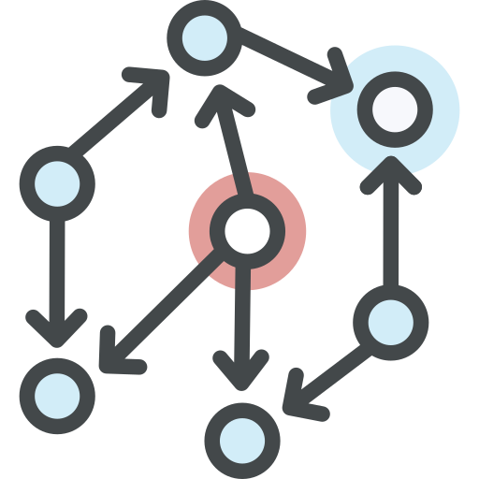


Problem Statement
Collecting Tourist Spots Dataset
How to collect the dataset of tourist spots in Bangladesh.
How to process and store the dataset for proper use.
Graph Construction
How to construct routes between tourist spots.
How to evaluate distances between one spot to another.
How to represent weight of nodes and edges.
Recommendation
How to select the candidate spots considering the start- and end- points.
How to measure the weighted cost of a route.
User Interaction
How to make a user-friendly and effective website and mobile application.

Slide 10
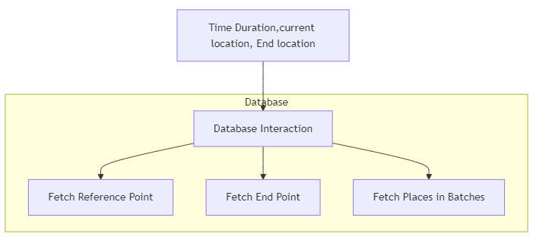
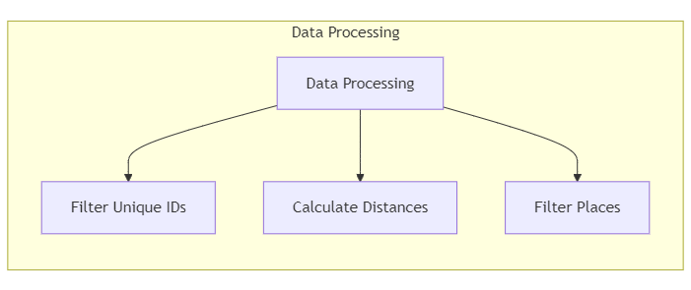
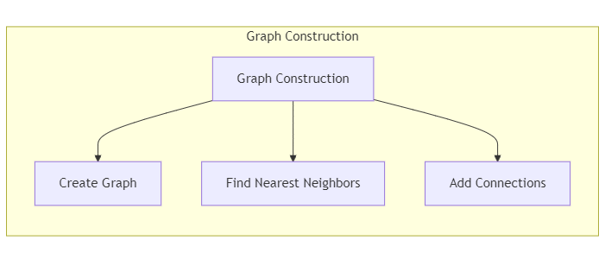
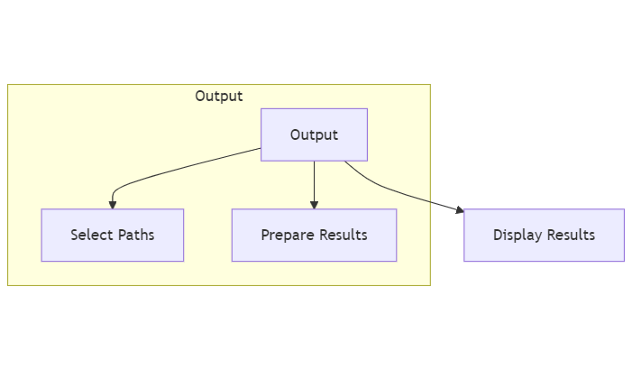
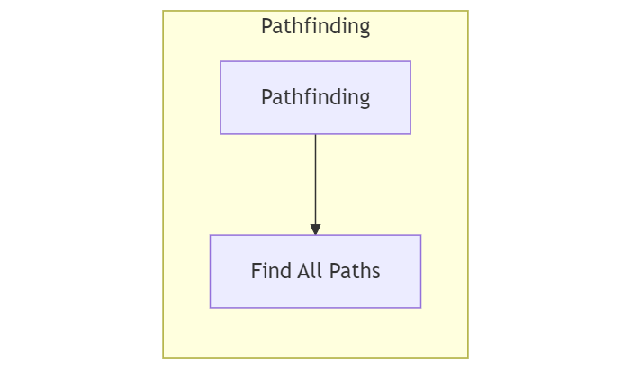
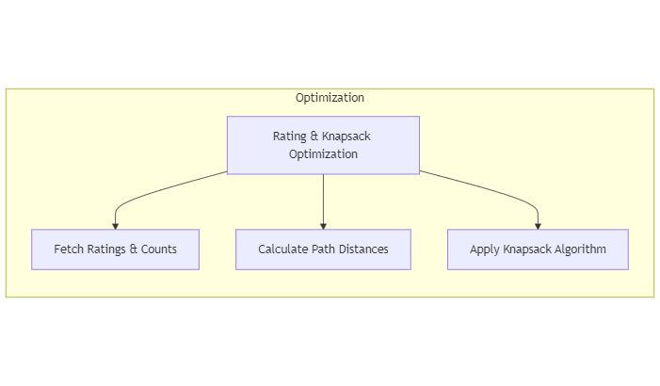
Block Diagram
Graph Construction
Recommendation
Graph

Slide 11
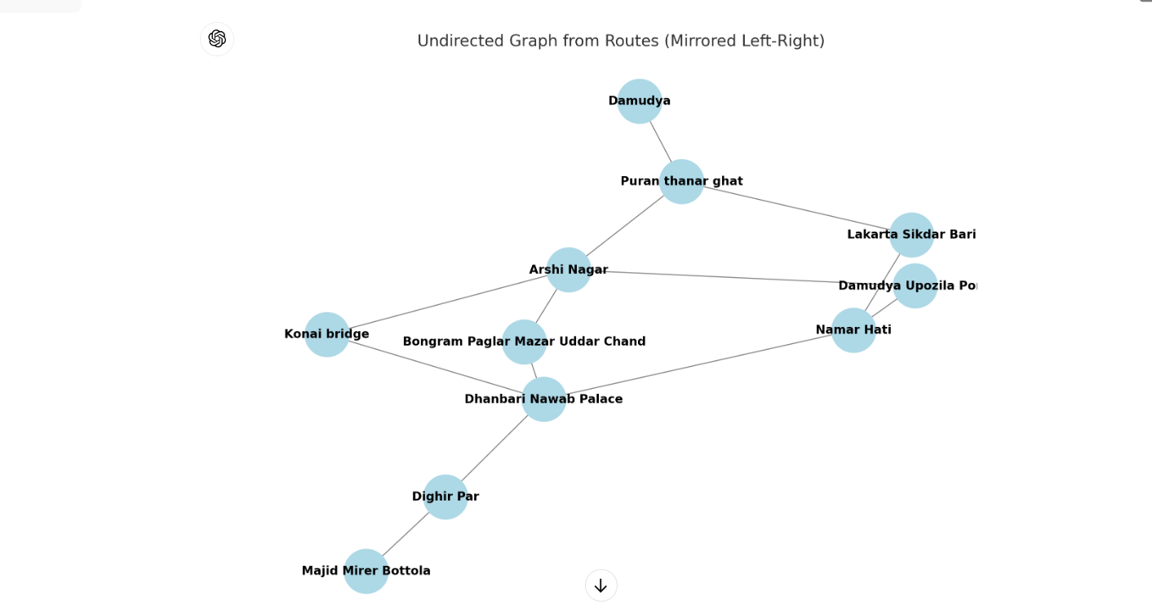
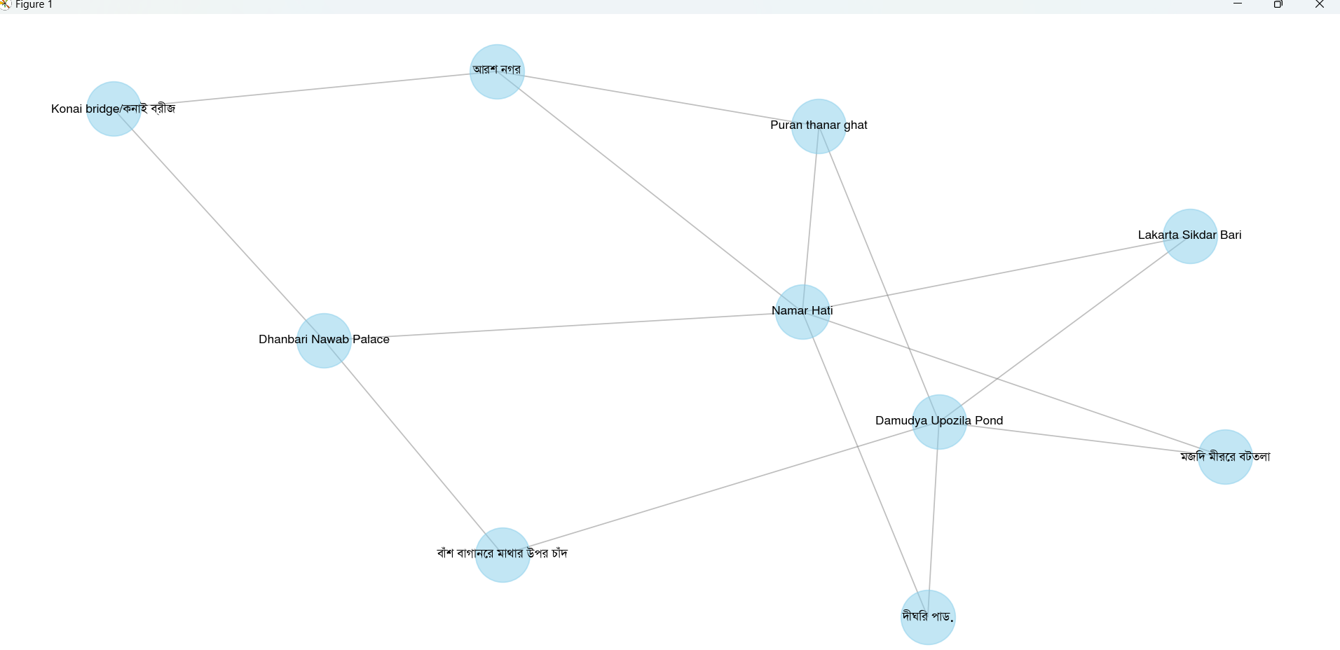
Graph

Slide 12

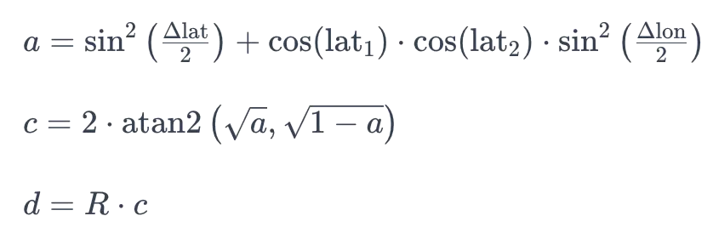
Short Description of Implementation
Prepare data for travel route optimization.
Gather user input such as location, destination, and constraints. Retrieve the start point details from the database.
Retrieve the endpoint details from the database.
Filter out duplicate places
Graph Construction Section:
Create a graph with places as nodes and distances as edges.
Calculate the shortest distance between two points by haversine distance.

Slide 13
Short Description of Implementation
Identify nearby places within a fixed distance.
Explore all possible paths using BFS.
Recommendation Section
Retrieve ratings and visit counts for each place from the database.
Knapsack Problem (0/1 Knapsack):
dp[w]=max(dp[w],dp[w−weights[i]]+values[i])
Where:
Weights[i] is the weight of the i-th item,
Values[i] is the value of the iii-th item,
dp[w] is the maximum value achievable with capacity w.
Select the optimal paths that maximize the rating while respecting the time constraints.

Slide 14
Experimental Evaluation
Input:
Travel Time: 4 hours
Current Location: Damudya Upazila Pond
End Location: Dhanbari Nawab Palace
Algorithm | Output
Knapsack with dynamic optimization Runtime: 35.50 seconds | Route 5: Damudya Upazila Pond -> Lakarta Sikdar Bari -> Namar Hati -> Dhanbari Nawab Palace Score: 992.01, Travel Time: 3.56 hours Route 13: Damudya Upazila Pond -> Puran thanar ghat -> আরার নগর -> Konai bridge/কোনাই ব্রিজ -> Dhanbari Nawab Palace Score: 962.41, Travel Time: 3.56 hours Route 15: Damudya Upazila Pond -> Puran thanar ghat -> Namar Hati -> আরার নগর -> Dhanbari Nawab Palace Score: 961.41, Travel Time: 3.56 hours
Multiple criteria decision making Runtime: 27.37 seconds | Route 5: Damudya Upazila Pond -> Lakarta Sikdar Bari -> Namar Hati -> Dhanbari Nawab Palace Score: 298.09, Travel Time: 3.56 hours Route 13: Damudya Upazila Pond -> Puran thanar ghat -> আরার নগর -> Konai bridge/কোনাই ব্রিজ -> Dhanbari Nawab Palace Score: 291.37, Travel Time: 3.56 hours Route 15: Damudya Upazila Pond -> Puran thanar ghat -> Namar Hati -> আরার নগর -> Dhanbari Nawab Palace Score: 291.07, Travel Time: 3.56 hours

Slide 15
Experimental Evaluation
Input:
Travel Time: 4 hours
Current Location: Damudya Upazila Pond
End Location: Dhanbari Nawab Palace
Algorithm | Output
Knapsack dynamic with Traffic optimization Runtime: 24.11 seconds | Route 15: Damudya Upazila Pond -> Puran thanar ghat -> Namar Hati -> আরার নগর -> Dhanbari Nawab Palace Score: 949.51, Travel Time: 3.74 hours, Fuel Cost: 11.86 liters Route 12: Damudya Upazila Pond -> Puran thanar ghat -> আরার নগর -> বার্মা গার্ডেন খাজা উদ্দিন চাঁদ -> Dhanbari Nawab Palace Score: 948.55, Travel Time: 3.58 hours, Fuel Cost: 11.86 liters Route 1: Damudya Upazila Pond -> Puran thanar ghat -> আরার নগর -> Dhanbari Nawab Palace Score: 942.66, Travel Time: 3.13 hours, Fuel Cost: 11.86 liters
Simulated Annealing Runtime: 28.62 seconds | Route 1: Damudya Upazila Pond -> Puran thanar ghat -> আরার নগর -> Dhanbari Nawab Palace Score: 954.41, Travel Time: 3.56 hours Route 2: Damudya Upazila Pond -> Puran thanar ghat -> Namar Hati -> Dhanbari Nawab Palace Score: 951.41, Travel Time: 3.56 hours Route 3: Damudya Upazila Pond -> পদ্মা ভিউ -> Namar Hati -> Dhanbari Nawab Palace Score: 949.71, Travel Time: 3.56 hours

Slide 16
Conclusions
The project will deliver a robust and user-friendly recommendation system that enhances the tourist experience in Bangladesh by providing personalized and data-driven suggestions for top tourist destinations in each Upazila. The system will leverage advanced data processing techniques, geospatial calculations, and normalization methods to ensure accurate, relevant, and high-quality recommendations.

Slide 17
Appendix
Addressing of COs, Knowledge Profile (K), and Complex Engineering Problem (EP):
CO | CO Descriptions | K | EP
CO3 | We have achieved: Data Processing Distance Calculation Filtering Places Graph Construction Pathfinding Knapsack Optimization User Interaction Database Management Output Visualization | (i)Problem Analysis[K1, K2, K3, K4] Distance Calculation: Uses Haversine formula to calculate distances between coordinates. Filtering Places: Removes duplicates and selects places based on proximity to the route and start/end points. Graph Construction: Creates a graph representing connections between places. Pathfinding: Finds possible routes between start and end points. | (i) Problem Analysis [EP1, EP2, EP3, EP6, EP7] Distance Accuracy: Ensures accurate distance calculations and route filtering. Unique Identification: Filters out duplicate places to ensure relevance. Efficient Graph Building: Constructs a graph to analyse connections and paths. Path Evaluation: Evaluates different routes for feasibility and relevance.

Slide 18
Appendix
CO | CO Descriptions | K | EP
CO4 | User Safety Environmental Consideration | (i) Design and Implementation [K5] Public Health Considerations: Ensured the project promotes user safety and data privacy. Environmental Considerations : helps reduce environmental impact by minimizing resource usage and lowering carbon emissions | (i) Design and Implementation [EP1, EP2, EP4, EP5, EP6, EP7] Safety and Accuracy: Ensures safe and accurate route recommendations by filtering and evaluating paths. Cultural and Societal Considerations: Incorporates user-defined locations and preferences in the design.
CO5 | Geospatial Tools Data Processing Libraries Graph Algorithms Optimization Techniques | Materials and Devices [K6] Modern Tools: Uses Python and libraries (e.g., mysql.connector, math, heapq) for data processing and analysis. | Materials and Devices [EP1, EP2, EP4, EP5] Data Handling: Manages large datasets with batch processing. Graph Algorithms: Applies graph-based algorithms for pathfinding and distance calculations.
CO6 | Societal Impact Safety Consideration | Social and Environmental Impact of Engineering [K7] Societal Impact: Provides tools for personalised route planning based on user preferences. Safety Considerations: Ensures safe travel recommendations by filtering places and paths. | Social and Environmental Impact of Engineering [EP2, EP5, EP6] User-Centric Design: Considers user input and preferences in route planning. Safety and Relevance: Ensures routes are safe and relevant to user-defined criteria.

Slide 19
QUESTIONS

Slide 20


